Slide 1
CS M117
Computer Networks: The Physical Layer
June 26; SUMMER 2018
Instructor Revaz Dzhanidze
revazd@cs.ucla.edu
revazd@ee.ucla.edu
Ph: 4-4579; 3409 BH
TA
Arjun Lakshmipathy | 3704 BH | Ph: 5-8659 | arjun.lakshmipathy@cs.ucla.edu

Slide 2
Office Hours (tentative)
Professor:
11:00-11:50 am T/R, 3704 BH / 3409 BH
TA
1A, 1B. 2:00-2:50 am Wednesdays 3704 BH
Additional lab time may be scheduled by appointment with the TA.
The TA may announce additional lab time
Newsgroup and Website
https://ccle.ucla.edu/course/view/18Su-COMSCIM117-1

Slide 3
Course Objectives
To provide fundamental knowledge of the theory underlying wireless data communication systems.
To provide hands-on experience by performing a series of wireless laboratory experiments with a number of important laboratory instruments.
To gain experience in preparing formal technical project and report based upon series of laboratory experiments and special experiments using set of wireless communication network.
CS M117 course uses some knowledge of materials
obtained in one of the following classes:
SCI 31, 33,118 or EE 132B

Slide 4
CS M117 is a 4 unit course.
Workload
Weekly
2 hours lecture
1 hours homework
2 hours lab experiment
1 hours report
2 hours outside study
2 hours project
No Midterms, No Finals

Slide 5
Lab Experiments
Laboratory Experiments (Wednesdays 3704 BH):
Lab 1 - 802.11b Wireless LAN
Lab 2 – 802.15 Bluetooth communications
PJ. Lab– Based on Special Wireless
Experiments (SWE)

Slide 6
Quiz Test Sketch
(The quiz is more conceptual than computational).
CS M117
Multiple-Choice
b) Ability to design and conduct experiments, as well as to analyze and interpret data;
19. Before data can be transmitted, they must be transformed to _______.
a. Periodic signals b. Electromagnetic signals
c. Aperiodic signals d. Low-frequency sine waves
31. As frequency increases, the period ________.
a. Decreases b. Increases
c. Remains the same d. Doubles

Slide 7
Report
“Wireless Data Transmission”
Chien _ _ _ _
Report Title Page Sample
CS M117
Winter 14
Partners:
Alexander _ _ _ _
Xiaohang _ _ _ _

Slide 8
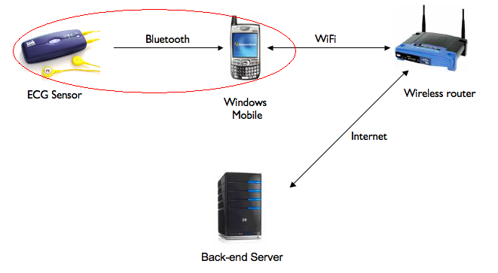
Abstract
Report is implementing a mobile application that receiver medical data (electrocardiogram/ECG) from the Alive heart-monitoring sensor through Bluetooth and send the data to a server through TCP/IP.
Our Team is responsible for retrieving medical data from the ECG sensor.

Slide 9
Grading
Grading:
Homework (HW) (2) = 10%
Lab Report (1) = 15%
Project (1) = 60%
Quiz Test (1) = 15%
RDS (2) P., No P.
Final Grade (FG) 100%
Conversion of a numerical scores to the letter grades
A+ | A | A- | B+ | B | B-
[100-96] | (96-93] | (93-90] | (90-86] | (86-83] | (83-80]

Slide 10
Recommended References
M. Gerla, R. Dzhanidze: Course Notes for CS 117 Summer. 2018.
1081 Westwood Blvd.- Special needs Entrance / 1080 Broxton Av.-Main Entrance; (310) 443-3303
A.S. Tanenbaum, “Computer Networks”, Prentice Hall, 2002, Fourth Edition, ISBN 0-13-066102-3
B.A. Forouzan. “Data Communications and Networking”, Mc-Graw Hill Higher Education, 2004, Third Edition. ISBN 0-07-292005-X.
Materials on CS M117 course Web Site

Slide 11
CS 117: Project List

Slide 12
Proposed project: by choice:
Project #1 “Health. Net
Connecting Patients & Doctors”,
Project #2 “Gateway System Implementation”
(These projects are developed as a part of Special Wireless Lab Experiments)

Slide 13
CS 117 Project Grading Policy
Project proposal Presentation – 15%
Attendance – 10%
  You can absent up to two times.
Final Presentation – 35%
  Group presentation; all member will participate; up to 15 minutes
Final Report – 40%

Slide 14
 | Lectures Tuesday. 12:00-1:50 pm 9436 BH |  | DIS A1: Wed. 10:00-11:50 pm B1: Wed. 12:00-1:50 pm 3704 BH | Lectures Thursday. 12:00-1:50 pm 9436 BH
1 | Introduction to CS M117 class Lec.1. Modulation (Instr.) Computer networks, (Read. 1) June 26th |  | No Meetings June 27th | Lec.2. Wireless Channels. (Data Encoding, Analog to Digital Conversion). Read. 2
 |  |  |  | Intro to the projects June 28th
2 | Lec.3. Wireless LAN (Instr.) (Prelab HW1, due 07/11) |  | HOLLYDAY July 4th | L.4. BT PAN. (Instr.) (Prelab HW2 due 07/18)
 | Project proposed by the TA July 3rd |  |  | Project proposed by students July 5th
3 | L.5. Cellular Communications |  | Lab # 1 (W. LAN) RDS* 1 due on 07/18 July 11th | L.6. Ad-Hoc Communications L.7. ZigBee Communications
 | Project Assignments. Teams formed July 10th |  |  | Final Projects Clinic July 12th
4 | Equipment order July 17th |  | Lab # 2 BT PAN REPORT due on 07/25 July 18th | Discussion of the projects July 19th
5 | SWE Discussion July 24th |  | Equipment handed out, July 25th | SWE* July 26th
6 | SWE* For Project With tutor supervision PROJECTS Due 08/21- -22-23 | SWE* July 31st | SWE* August 1st | SWE* August 2nd
7 |  | SWE* August 7th | SWE* August 8th | SWE* August 9th
8 |  | L.8.Concluding August 14th | SWE* August 15th | Quiz Test August 16th
9 |  | Project Presentation August 21st | Project Presentation August 22nd | Project Presentation August 23rd

Slide 15
THANK YOU!

